Slide 1





Team Name : INNOVATORS Team Members : Chaithanya B S Inchara Mahesh Suchithra N Supriya H N

Slide 2
Problem Statement:
Smart Meeting Summaries
Convert long Zoom/Google Meet calls into concise summaries with key action points using AI. -Helps professionals, students, and organizations save time and stay focused.

Slide 3
Solution:
Our AI-powered Smart Meeting Summaries system automatically transcribes, summarizes, and extracts key action points from virtual meetings. It helps professionals and organizations save time, improve productivity, and ensure important discussions are well-documented. The system seamlessly integrates with collaboration tools to deliver concise and actionable insights.
1. Real-time Transcription : Converts Speech to Text Automatically
Explanation: The AI listens to the meeting in real-time and converts spoken words into written text.
Tools & Technologies: OpenAI Whisper – High-accuracy, multilingual transcription. Google Speech-to-Text API – Cloud-based transcription service. Deepgram / AssemblyAI – Real-time transcription APIs for better speed. Vosk API – Offline speech recognition for on-device processing.

Slide 4
2. AI-Powered Summarization – Extracts Key Discussion Points
Explanation: The AI processes the full transcript and generates a concise summary with the most important topics and decisions.
Tools & Technologies: GPT-4 / LLaMA / Claude AI – Large Language Models for intelligent summarization. BART (Facebook AI), T5 (Google AI) – NLP models specialized for summarization. TextRank Algorithm – Extracts key phrases based on ranking methods.
3. Action Item Extraction – Identifies Decisions, Tasks, and Deadlines
Explanation: The AI scans the conversation for actionable tasks, identifying: Who is responsible for what? Deadlines and follow-ups.AI uses Named Entity Recognition (NER) to detect names, dates, and responsibilities.
Tools & Technologies: spaCy / NLTK – NLP libraries for extracting structured information. OpenAI / Claude AI / Gemini AI – LLMs that can structure action items. Regex & Rule-based models – Identifies common action phrases like “We need to…”, “Let’s finalize…”, etc.

Slide 5
4. Seamless Integration – Works with Zoom, Google Meet, Slack, Email, Notion
Explanation: he AI system automatically connects with meeting platforms and collaboration tools to fetch meeting recordings and distribute summaries. API integrations ensure smooth data transfer between the AI system and these platforms.
Tools & Technologies: Zoom API / Google Meet API – Fetch live audio/video streams for processing. Slack API – Send meeting summaries directly to Slack channels. Notion API – Save structured summaries into Notion workspaces. Twilio / SendGrid – Email API for automated email delivery of summaries.
5. Automated Summary Delivery – Sends Concise Meeting Notes via Email, Slack, or PDF
Explanation: After processing, the AI system automatically sends the summary to participants via their preferred communication channels. Summaries can be delivered as:Plain text in emails or Slack messages. Formatted documents (PDF, Word, or Notion pages).A dashboard where users can access past summaries.
Tools & Technologies: Flask / FastAPI / Django – Backend API for summary distribution. SendGrid / Amazon SES – Email automation services. Pandas & ReportLab – For generating structured PDF reports. Google Drive / OneDrive API – Store and retrieve meeting summaries.

Slide 6
Tech Architect
1. User Interaction Layer (Frontend & Integrations):
Web/Mobile App (React.js/Next.js, Flutter)
Microsoft Teams Integration (fetches meeting recordings/transcriptions)
Microsoft Outlook & OneNote (receives summaries)
2. Data Processing Layer (Backend & AI Pipelines):
Azure Speech-to-Text converts meeting audio into text.
Azure OpenAI (GPT-based models) generates key summaries.
Azure Text Analytics extracts key action points and decisions.
3. Storage & Database Layer:
Azure SQL Database / Cosmos DB – Stores meeting history, transcripts, and summaries.
Azure Blob Storage – Stores audio recordings and processed text.

Slide 7
4. Delivery & Notification Layer(Automated Summary Distribution):
Microsoft Outlook (Email)
Microsoft Teams (Message or Channel Post)
OneNote/Loop (for documentation)
PDF reports (generated via Azure Functions)
5. Cloud Infrastructure & Deployment(Hosting & Scalability):
Backend: Python (FastAPI/Django), hosted on Azure App Services
Cloud: Azure Functions & Logic Apps for serverless processing
CI/CD: GitHub Actions, Docker, Kubernetes for deployment
Monitoring: Azure Monitor + Log Analytics

Slide 8
How is Microsoft Azure used?
Speech-to-Text (Transcription) Azure Speech-to-Text API (from Azure Cognitive Services): Can convert meeting audio into text.
AI Summarization & Action Item Extraction Azure OpenAI Service (GPT-4) : Can summarize meetings and extract key action points. Use Azure Text Analytics API (part of Cognitive Services) for keyword extraction & sentiment analysis.
Storage & Database Azure Blob Storage: Store meeting audio, transcripts, and summaries.
Azure Cosmos DB / Azure SQL: Store structured data (e.g., meeting metadata, action items).
Azure Functions: Run serverless tasks like processing meeting summaries.
Azure API Management: Secure and manage your backend APIs.
Microsoft Teams & Azure Integration Microsoft Graph API: Fetch meeting recordings/transcripts directly from Teams.
Power Automate: Automate sending meeting summaries to emails, Slack, Notion.
Azure Bot Service: Build a Teams chatbot to send AI-generated summaries.

Slide 9
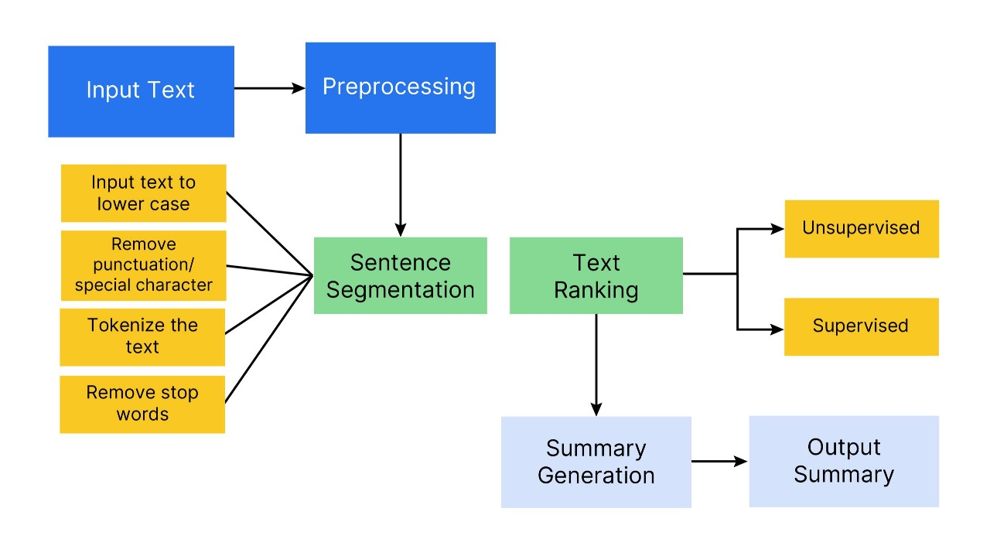
Tech Diagram, Stack & GitHub Repo Link
Tech Diagram:

Slide 10
Tech Stack:
Frontend:
React / Blazor: For building a web interface to view and manage summaries.
Backend:
Azure Functions: For handling API requests and processing.
Node.js / .NET Core: For business logic and integration.
Meeting Integration:.
Zoom/Google Meet API: For Zoom/Google Meet integration.
Transcription:
Azure Speech to Text API: Converts meeting audio to text.

Slide 11
5. NLP & Summarization:
Azure Text Analytics API: For extracting insights and entities.
Azure OpenAI (GPT): For generating concise summaries.
6. Database:
Azure SQL Database / Cosmos DB: For storing summaries and user data.
Azure Blob Storage: For storing recordings.
7. Notifications:
Azure Logic Apps / Power Automate: For automating notifications.
SendGrid / Azure Communication Services: For email alerts.
GitHub Repo Link https://github.com/suchithra2003

Slide 12


